Slide 1
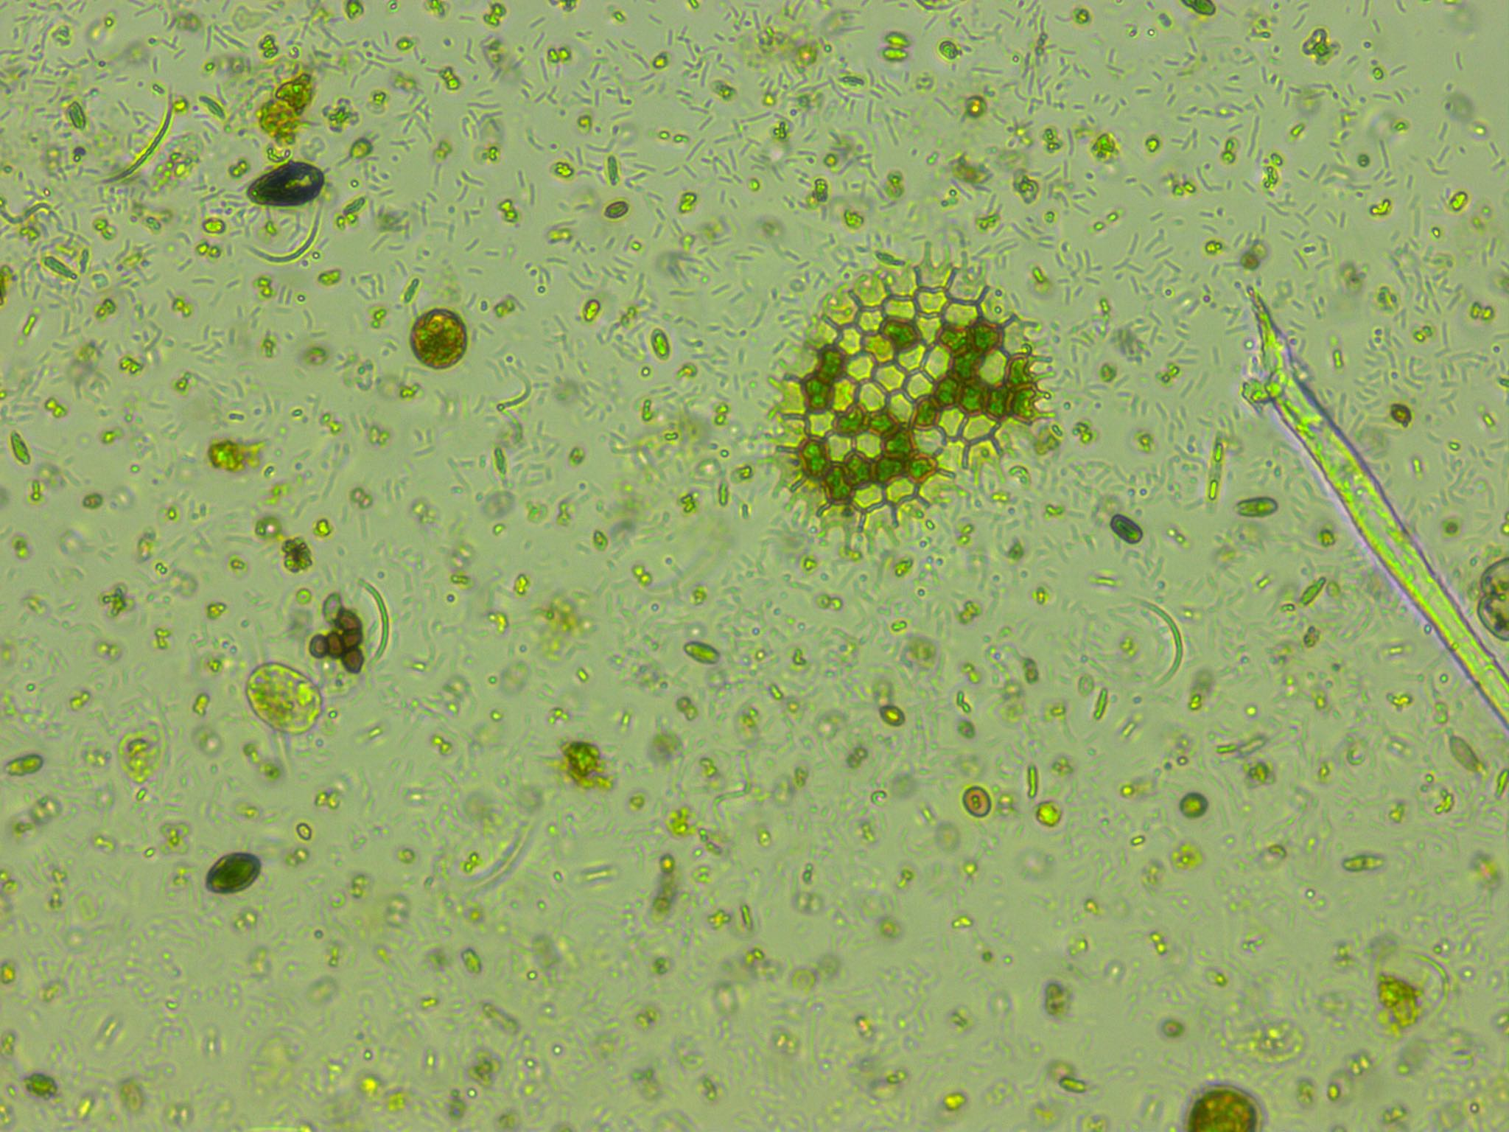
Predicting phytoplankton metabolism from the individual size distribution
Daniel Padfield

Slide 2
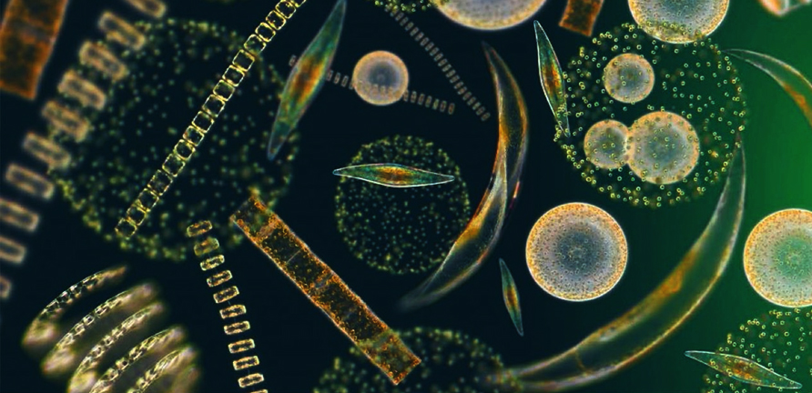
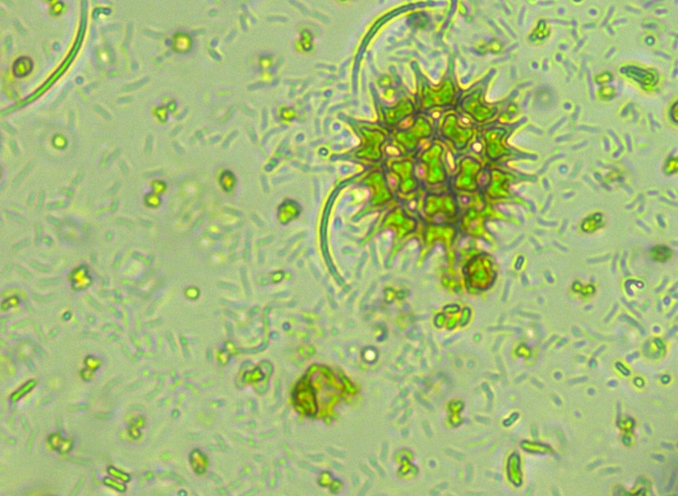
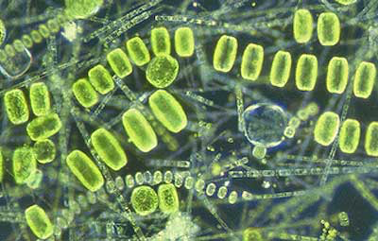
Phytoplankton are key for the carbon cycle
~50% of annual carbon fixation
Fuel entire ocean food webs

Slide 3
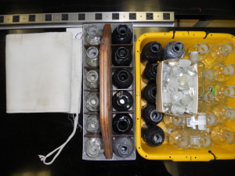
Current measurements of metabolism
Bottle incubations – in vivo
Snapshot in time
Single community
Control over environmental variables

Slide 4
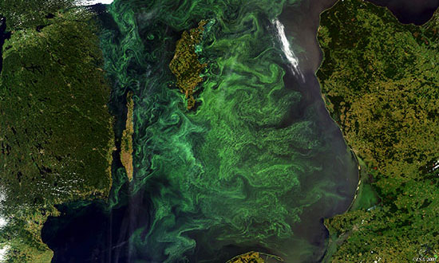
Current measurements of metabolism
Bottle incubations – in vivo
Gas measurements – in situ
Snapshot in time
Single community
Control over environmental variables
Integrates over large areas
Many communities and many different environmental conditions

Slide 5
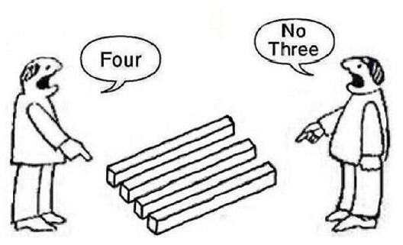
Current measurements of metabolism
Bottle incubations – in vivo
Gas measurements – in situ
Most of the open ocean is net heterotrophic
Most of the open ocean is net autotrophic

Slide 6

Crash course in metabolic theory

Slide 7

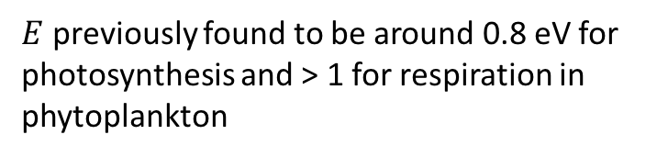
Crash course in metabolic theory
🔥🔥🔥🔥🔥🔥🔥
$$e^{\left.E(\frac{1}{kT_{c}}−\frac{1}{kT}\right)}$$
$E$ previously found to be around 0.8 eV for photosynthesis and > 1 for respiration in phytoplankton

Slide 8
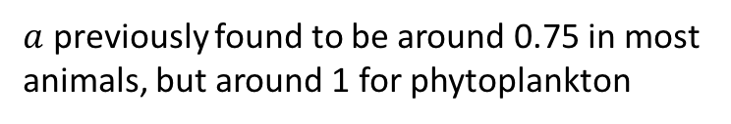

Crash course in metabolic theory
$$m_{i}^{a}$$
$a$ previously found to be around 0.75 in most animals, but around 1 for phytoplankton

Slide 9
Crash course in metabolic theory
$$m_{i}^{a}$$
$a$ previously found to be around 0.75 in most animals, but around 1 for phytoplankton

Slide 10
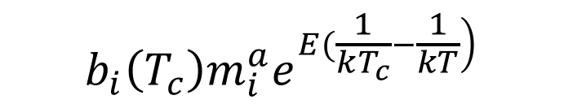
Crash course in metabolic theory
🔥🔥🔥🔥🔥🔥🔥
🔥🔥🔥🔥🔥🔥🔥
$$b_{i}\left(T_{c}\right)m_{i}^{a}e^{\left.E(\frac{1}{kT_{c}}−\frac{1}{kT}\right)}$$

Slide 11
Crash course in metabolic theory
🔥🔥🔥🔥🔥🔥🔥
$$b_{i}\left(T_{c}\right)m_{i}^{a}e^{\left.E(\frac{1}{kT_{c}}−\frac{1}{kT}\right)}$$

Slide 12
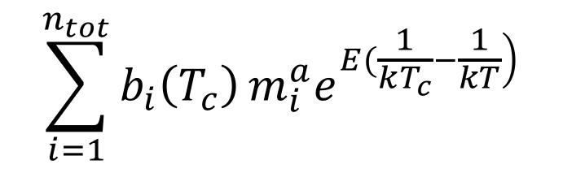
Crash course in metabolic theory
🔥🔥🔥🔥🔥🔥🔥
$$\sum_{i=1}^{n_{tot}}{b_{i}\left(T_{c}\right)}m_{i}^{a}e^{\left.E(\frac{1}{kT_{c}}−\frac{1}{kT}\right)}$$
🔥🔥🔥

Slide 13
Crash course in metabolic theory
🔥🔥🔥🔥🔥
🔥🔥
🔥🔥🔥🔥🔥🔥🔥
$$\sum_{i=1}^{n_{tot}}{b_{i}\left(T_{c}\right)}m_{i}^{a}e^{\left.E(\frac{1}{kT_{c}}−\frac{1}{kT}\right)}$$
🔥🔥🔥
🔥🔥

Slide 14
Crash course in metabolic theory
🔥🔥🔥🔥🔥
🔥🔥
🔥
🔥🔥🔥🔥🔥🔥🔥
🔥🔥🔥🔥🔥🔥🔥🔥
$$\sum_{i=1}^{n_{tot}}{b_{i}\left(T_{c}\right)}m_{i}^{a}e^{\left.E(\frac{1}{kT_{c}}−\frac{1}{kT}\right)}$$
🔥🔥🔥
🔥🔥

Slide 15
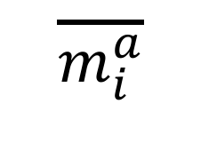
Zero-sum dynamics
$$\overline{m_{i}^{a}}$$

Slide 16
Zero-sum dynamics
🔥🔥🔥
🔥🔥🔥
🔥🔥🔥
🔥🔥🔥
🔥🔥🔥
🔥🔥🔥
🔥🔥🔥
🔥🔥🔥
🔥🔥🔥
$$\overline{m_{i}^{a}}$$

Slide 17
Zero-sum dynamics
$$\overline{m_{i}^{a}}$$

Slide 18
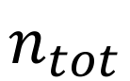
Zero-sum dynamics
$$\overline{m_{i}^{a}}$$
$$n_{tot}$$

Slide 19
Predictions
Can predict metabolism of whole communities from the size- and temperature-dependence of individuals
Across-communities, there will be a trade off between total abundance and average individual metabolic rate
Trade offs mean raw metabolism may be stable across communities

Slide 20
Experimental setup
10 years warming : half 4ºC above ambient

Slide 21
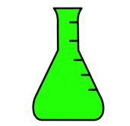
Experimental setup
How do the communities and their functioning change in response to long-term and short-term warming
10 years warming : half 4ºC above ambient
Cool incubator ~ 4 weeks
Warm incubator ~ 4 weeks

Slide 22
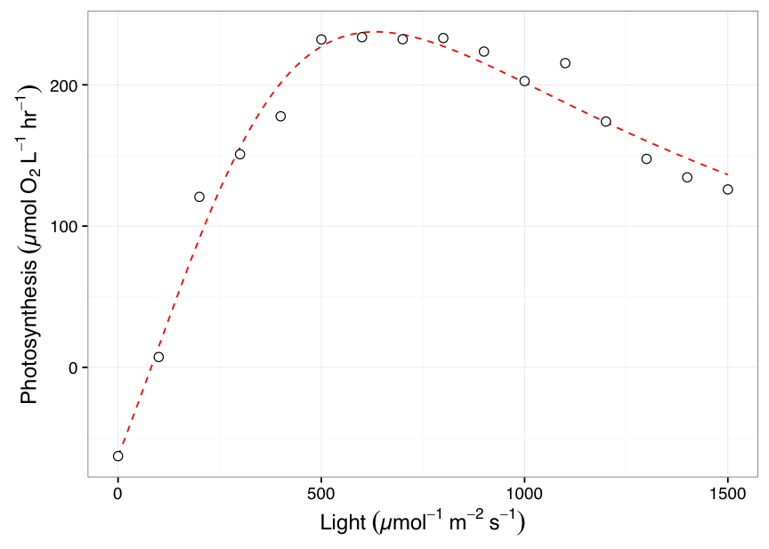
Measurements
+
Metabolism @ incubator temperature
1 point for each microcosm
Size distribution
> 300 points per sample!

Slide 23
Long-term warming changes communities

Slide 24
No difference in measured raw metabolism

Slide 25
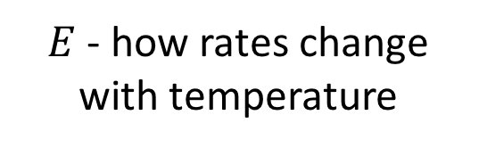
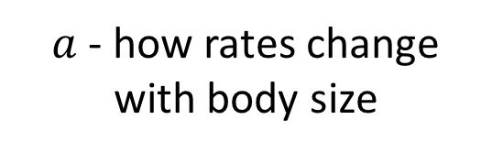
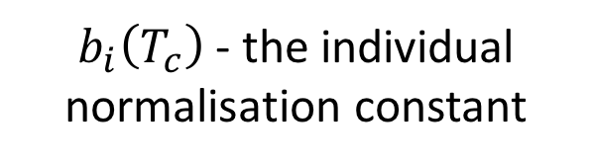
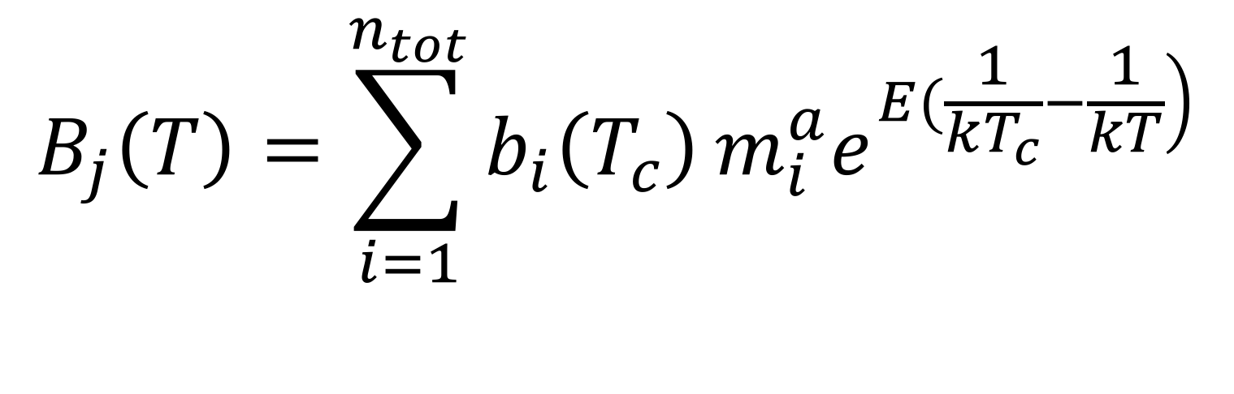
Model
$a$ - how rates change with body size
$$B_{j}\left(T\right)=\sum_{i=1}^{n_{tot}}{b_{i}\left(T_{c}\right)}m_{i}^{a}e^{\left.E(\frac{1}{kT_{c}}−\frac{1}{kT}\right)}$$
$b_{i}\left(T_{c}\right)$ - the individual normalisation constant
$E$ - how rates change with temperature

Slide 26
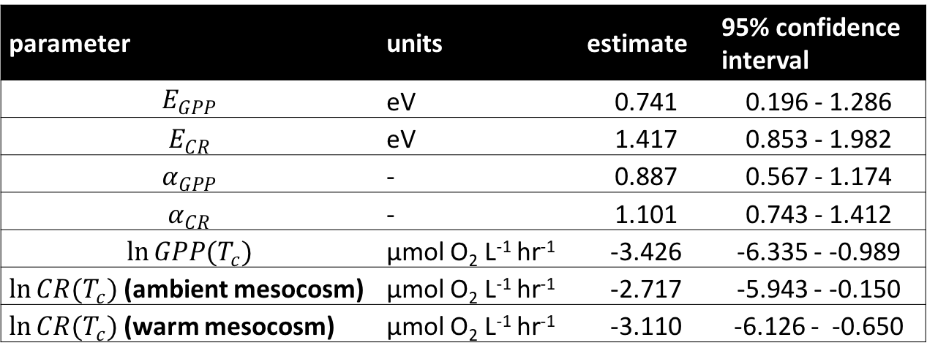
Model predicts size and temperature-dependence
parameter | units | estimate | 95% confidence interval
$$E_{GPP}$$ | eV | 0.741 | 0.196 - 1.286
$$E_{CR}$$ | eV | 1.417 | 0.853 - 1.982
$$α_{GPP}$$ | - | 0.887 | 0.567 - 1.174
$$α_{CR}$$ | - | 1.101 | 0.743 - 1.412
$$\ln{GPP(T_{c})}$$ | µmol O₂ L⁻¹ hr⁻¹ | -3.426 | -6.335 - -0.989
$\ln{CR(T_{c})}$ (ambient mesocosm) | µmol O₂ L⁻¹ hr⁻¹ | -2.717 | -5.943 - -0.150
$\ln{CR(T_{c})}$ (warm mesocosm) | µmol O₂ L⁻¹ hr⁻¹ | -3.110 | -6.126 - -0.650

Slide 27
Model predicts size and temperature-dependence
parameter | units | estimate | 95% confidence interval
$$E_{GPP}$$ | eV | 0.741 | 0.196 - 1.286
$$E_{CR}$$ | eV | 1.417 | 0.853 - 1.982
$$α_{GPP}$$ | - | 0.887 | 0.567 - 1.174
$$α_{CR}$$ | - | 1.101 | 0.743 - 1.412
$$\ln{GPP(T_{c})}$$ | µmol O₂ L⁻¹ hr⁻¹ | -3.426 | -6.335 - -0.989
$\ln{CR(T_{c})}$ (ambient mesocosm) | µmol O₂ L⁻¹ hr⁻¹ | -2.717 | -5.943 - -0.150
$\ln{CR(T_{c})}$ (warm mesocosm) | µmol O₂ L⁻¹ hr⁻¹ | -3.110 | -6.126 - -0.650

Slide 28
Model predicts size and temperature-dependence
parameter | units | estimate | 95% confidence interval
$$E_{GPP}$$ | eV | 0.741 | 0.196 - 1.286
$$E_{CR}$$ | eV | 1.417 | 0.853 - 1.982
$$α_{GPP}$$ | - | 0.887 | 0.567 - 1.174
$$α_{CR}$$ | - | 1.101 | 0.743 - 1.412
$$\ln{GPP(T_{c})}$$ | µmol O₂ L⁻¹ hr⁻¹ | -3.426 | -6.335 - -0.989
$\ln{CR(T_{c})}$ (ambient mesocosm) | µmol O₂ L⁻¹ hr⁻¹ | -2.717 | -5.943 - -0.150
$\ln{CR(T_{c})}$ (warm mesocosm) | µmol O₂ L⁻¹ hr⁻¹ | -3.110 | -6.126 - -0.650

Slide 29
Model predicts size and temperature-dependence
parameter | units | estimate | 95% confidence interval
$$E_{GPP}$$ | eV | 0.741 | 0.196 - 1.286
$$E_{CR}$$ | eV | 1.417 | 0.853 - 1.982
$$α_{GPP}$$ | - | 0.887 | 0.567 - 1.174
$$α_{CR}$$ | - | 1.101 | 0.743 - 1.412
$$\ln{GPP(T_{c})}$$ | µmol O₂ L⁻¹ hr⁻¹ | -3.426 | -6.335 - -0.989
$\ln{CR(T_{c})}$ (ambient mesocosm) | µmol O₂ L⁻¹ hr⁻¹ | -2.717 | -5.943 - -0.150
$\ln{CR(T_{c})}$ (warm mesocosm) | µmol O₂ L⁻¹ hr⁻¹ | -3.110 | -6.126 - -0.650

Slide 30
Model does a pretty good job!

Slide 31
Paradoxical result?

Slide 32
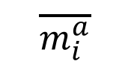
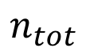
Zero-sum dynamics
$$\overline{m_{i}^{a}}$$
$$n_{tot}$$

Slide 33
Zero-sum dynamics
$$\overline{m_{i}^{a}}$$
$$n_{tot}$$
Slope = - 1.16 (95% CI: -1.58 - -0.86)
Not different from -1

Slide 34
Zero-sum dynamics
$$\overline{m_{i}^{a}}$$
$$n_{tot}$$
Slope = - 1.16 (95% CI: -1.58 - -0.86)
Not different from -1
Nutrient concentrations are going to be key for determining response to warming.

Slide 35
Conclusions
Empirically validated some key assumptions of metabolic theory and zero sum dynamics
Can potentially estimate metabolism purely from the size distribution of a plankton community!

Slide 36
Thanks for listening!

